Slide 1
“Enhancing SMEs’ Resilience After Lock Down”
IMPLEMENTING THE OMNICHANNEL MODEL AND INCREASING CONVENIENCE
By: INTERNET WEB SOLUTIONS

Slide 2
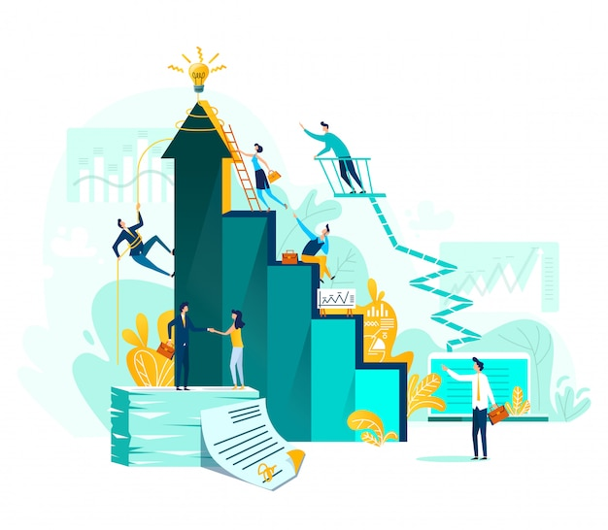
OBJECTIVES AND GOALS
At the end of this module you will be able to:
Grasp the omnichannel essentials, strengths and weaknesses
Learn how to differentiate it from multichannel actions
Know more about proven omnichannel strategies

Slide 3
INDEX
Unit 1: Omnichannel basics and strategies
What is Omnichannel
Differences between Omnichannel and Multichannel
Examples of Omnichannel strategies
Benefits and challenges

Slide 4
UNIT 1: Omnichannel basics and strategies
SECTION 1.1.: What is Omnichannel
Stores
Loyalty Programs
Kiosks
Upsell and cross-sell
Clienteling
Coupons
E-commerce
Email newsletters
Mobile & SMS
Google Adwords
Carts
Campaigns
It’s a model that aims to give customers a tailored experience via a variety of communication channels, to turn visits into sales.
It enables a wider range of opportunities to get in touch with potential customers
This exclusive experience covers:
Physical visits (to stores) to see and touch the product
Online visits (to e-shops) and demonstrations of product characteristics and specifications
Taking into account potential customer features and desires, marketing on social media
Omnichannel
Social Media
Social CRM
Social Listening
Social Enterprise
Custom Audiences
Call Centers
Case management
Upsell
Voice Campaigns
Service Level Agreement

Slide 5
UNIT 1: Omnichannel basics and strategies
SECTION 1.2.: Differences between Omnichannel and Multichannel
Multichannel
Omnichannel
Multichannel: The use of all channels (physical store, mobile, online marketing) to contact customers without a connection between the channels.
Omni-channel: a modality that provides seamless integration and response between the channels.
Physical Store
Mobile
Online Marketplace
eCommerce
User
eCommerce
Online Marketplace
Mobile
Physical Store
User

Slide 6
UNIT 1: Omnichannel basics and strategies
SECTION 1.3.: Examples of Omnichannel strategies
Now, let’s get a glimpse of how an omnichannel experience works that englobes both physical and online stores:
Mobile. A social media user sees a friend posting about her brand new laptop. Coincidentally, this user is also searching for a laptop, so she enters the link her friend included in her post to see if the product’s specifications match what she is looking for. Almost out of battery, the user locks and puts away the phone
Online Marketplace. Once home, the user remembered the laptop again and entered the link from before. The store recognizes the returning user and the laptop pops up as a recently viewed item. Now, she can have an in-depth look at the laptop, and also compare it to other options available.

Slide 7
UNIT 1: Omnichannel basics and strategies
SECTION 1.3.: Examples of Omnichannel strategies
Physical Store: Still not convinced, our user wants to see the chosen product(s) live to get an idea of its physical features (touch, weight, size, ergonomy…), so she goes to a physical store that has it. When connecting to the store’s mobile network, the staff learns about the user’s laptop searches, which allows them to better assist her and therefore be closer to landing the sale.
Delivering: After the purchase, our user can choose between taking the product home or having it shipped home. If delivery is chosen, the process can be tracked using smartphones, tablets or laptops.
After-sales: Having checked the product has been successfully received, the store makes a follow-up call to assess the current (great) level of satisfaction of the user. However, some days later, she has some queries for customer service, having saved all the information on her order, the staff is able to answer all her queries swiftly and effectively.

Slide 8
UNIT 1: Omnichannel basics and strategies
SECTION 1.4.: Benefits and challenges (1)
Integrated Communication and Analytics. In order to harness the near-endless amount of data generated by all communication channels, customers’ needs and desires must be always considered. To do so, an Omnichannel approach opens a world of possibilities: its cross-channel possibilities allow businesses to effectively administer customer data regardless of their source and execute platform-wide profile comparisons.
Meet customers where they are. Client profiles should be handled as single entities across all channels in order to avoid potential information loss or corruption, which will result in higher quality, bespoke customer service and being able to reward customers no matter the chosen platform to make their purchases.

Slide 9
UNIT 1: Omnichannel basics and strategies
SECTION 1.4.: Benefits and challenges (2)
Obtain data from every transaction. Every individual transaction counts. Together, these bits of information work like tiles forming a mosaic and it is this “final picture” which will allow businesses to track and sort customers by demographics, profiles or buying persona. In turn, this is a crucial aspect of business system basic management.
Specific Audiences Targeted. Having established proper customer and transaction analysis, marketing and retail experiences can be fixated on selected target markets. You can use inbound links to tailor your online marketing campaigns to a definite group of people.

Slide 10
UNIT 1: Omnichannel basics and strategies
SECTION 1.4.: Benefits and challenges (3)
Business Integration. It is composed of five elements: 1) Customer service, 2) sales, 3) merchandising, 4) inventory, 5) enterprise resource planning. These elements combine to enhance the level of both customer service and products.
Experience and Service Focused Shopping. Providing multi-channel services and products is key to offering customers the best service available. To do so, Omnichannel management is paramount to providing proper service-focused shopping.

Slide 11
UNIT 1: Omnichannel basics and strategies
SECTION 1.4.: Benefits and challenges (4)
1. Service unification might prove difficult when taking
into account the price variances within channels
2. Order management might not be good enough
3. Stock-related inputs might not be as precise as needed
4. Customer Support might be incomplete or inexistent

Slide 12
UNIT 1: Omnichannel basics and strategies
SECTION 1.4.: Benefits and challenges (4)
5. Loyalty programs might not be as productive as needed
6. The merger between physical and digital worlds might not be completely clean due to culture clashes
7. Partners might not have previous experience with Omnichannel management

Slide 13
Key takeaways:
Omnichannel provides a tailored experience to turn visits into sales
Customers will experience seamless integrations between all channels’ content
This modality also opens a vast array of customization, tracking and targeting possibilities
Implementation is heavily reliant on coordination and customer services

Slide 14
Assessment test
Omnichannel englobes:
a.- Stores, e-commerce, social media, call centers
b.- Magazines, m-commerce, media stores, call centers
c.- Social media, e-commerce, training, cloud computing
2. Is customer support a challenge for the Omnichannel model?
a.- No
b.- Yes
c.- Only via telephone call
3. The main difference between Omnichannel and Multichannel is:
a.- Seamless integration between the channels
b.- Omnichannel has more channels
c.- An easier approach
4. Obtaining data from every transaction
a.- Enables tracking and sorting of customers
b.- Is always illegal
c.- Can fill up hard drives
5. It is a step of the Business Integration process:
a.- Internationalisation
b.- Team building
c.- Enterprise resource planning

Slide 15
Assessment test
Omnichannel englobes:
a.- Stores, e-commerce, social media, call centers
b.- Magazines, m-commerce, media stores, call centers
c.- Social media, e-commerce, training, cloud computing
2. Is customer support a challenge for the Omnichannel model?
a.- No
b.- Yes
c.- Only via telephone call
3. The main difference between Omnichannel and Multichannel is:
a.- Seamless integration between the channels
b.- Omnichannel has more channels
c.- An easier approach
4. Obtaining data from every transaction
a.- Enables tracking and sorting of customers
b.- Is always illegal
c.- Can fill up hard drives
5. It is a step of the Business Integration process:
a.- Internationalisation
b.- Team building
c.- Enterprise resource planning

Slide 16
UNIT 1: Omnichannel basics and strategies
SOURCES
Shopify --- https://www.shopify.com/enterprise/omni-channel-vs-multi-channel
Salesforce --- https://www.salesforce.com/eu/blog/2020/12/omnichannel-strategy-benefits.html#:~:text=An%20omnichannel%20strategy%20benefits%20businesses%20by%20providing%20them%20with%20a,and%20develop%20smarter%20replenishment%20practices.
Silverearth --- https://www.silverearth.com/5-challenges-of-omnichannel-business

Slide 17
Thank-you!

