Slide 1
“Enhancing SMEs’ Resilience After Lock Down”
HEALTH AND WORK-LIFE BALANCE DISORDERS-
SELF-LEADERSHIP AND SELF-AWARENESS
By: UNIVERSITY OF DUBROVNIK

Slide 2
OBJECTIVES AND GOALS
At the end of this module you will be able to:
Explain the concepts of self-awareness and self-leadership
Discuss the gains from growing self-leadership and self-awareness in business and in crises
Provide guidance on self-leadership and self-awareness development practices

Slide 3
INDEX
Unit 2: Self-leadership and self-awareness
Importance of knowing inner you
What is (not) self-leadership and self-awareness
Cultivating self-awareness
Cultivating self-leadership

Slide 4
UNIT 2: Self leadership and self awareness
SECTION 2.1.: The importance of knowing inner you
Rapid business environment strikes at the foundations of our personal and professional life
Self-awareness and self-leadership
Gaining importance in recent management debates and literature
Knowing inner you as a way to combat anxiety, stress and depression
Leads to higher job satisfaction, personal control, happiness and growth
Helps taking others’ perspectives

Slide 5
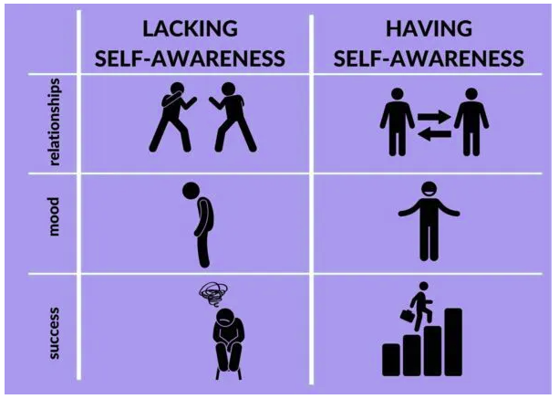
UNIT 2: Self leadership and self awareness
SECTION 2.1.: The importance of knowing inner you
Why it matters in business (some examples)
Prevents leaders from appearing arrogant
Helps giving sales pitches and handling feedback
Improves presentation experience
Being CEO of your own life (Peter Drucker, 2010)
The power to influence outcomes
Better decision making and communication
Understanding things from multiple perspectives
Freeing yourself from assumptions and biases
Keeping emotions under control
Lower stress and greater happiness
Why it matters in times of external shocks (e.g. Covid)?
Adaptation to changing work-life conditions
Reassessing priorities
Coping with stress, anxiety, isolation and uncertainty
Adjusting to new ways of doing business

Slide 6
UNIT 2: Self leadership and self awareness
SECTION 2.2.: What is (not) self-awareness and self-leadership
Self-awareness
The ability to focus on yourself and how your actions, thoughts or emotions do or do not align with your internal standards. It helps one to understand how other perceive you (Duval and Wicklund, 1972)
Becoming self-leader by being self-aware
Improving decision-making
Helping you assess weaknesses and strengths
Helping anticipate emotional reactions
Better controlling actions/behaviours
Reaching your goals more effectively
Self-leadership
The practice of intentionally influencing your thinking, feelings and actions towards your objectives (Bryant and Kazan, 2012)

Slide 7
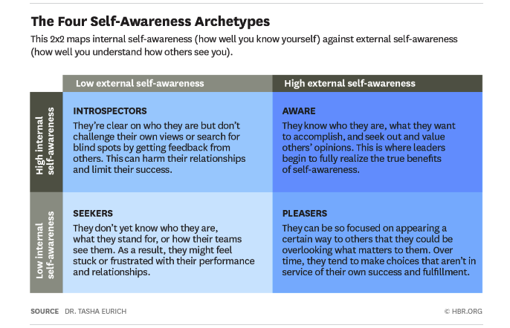
UNIT 2: Self leadership and self awareness
SECTION 2.2.: What is (not) self-awareness and self-leadership
Self-awareness can be
Internal – getting to know own values, passions and aspirations
External – understanding what kind of impression we make on other people
Source: Harward Business Review, Dr. Tasha Eurich, 2018

Slide 8
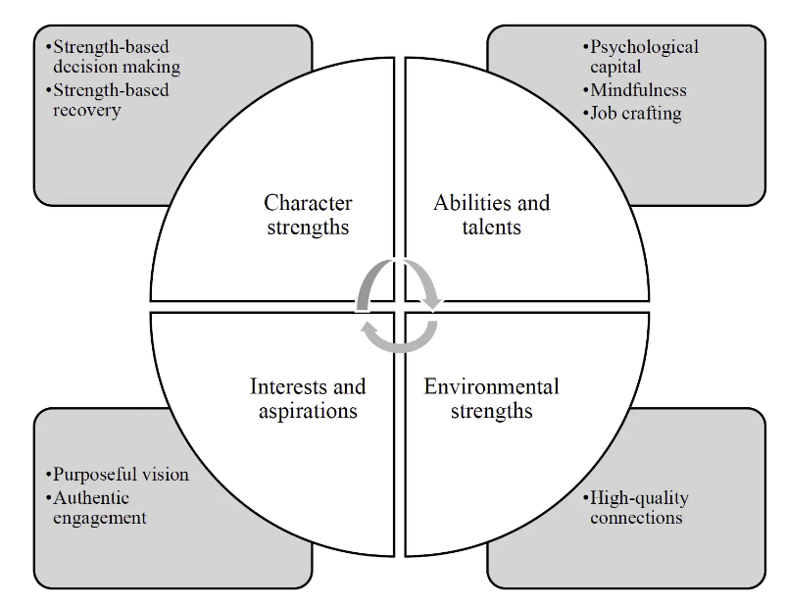
UNIT 2: Self leadership and self awareness
SECTION 2.2.: What is (not) self-awareness and self-leadership
The positive self-leadership capability model (Du Plessis, 2019)
It requires
Inner strengths
Aspirations
Talent and abilities
Connections with environment
Source: Du Plessis, 2019 in Neuhaus, 2020

Slide 9
UNIT 2: Self leadership and self awareness
SECTION 2.2.: What is (not) self-awareness and self-leadership
Self-awareness
Empathy
Adaptability
Confidence
Mindfulness
Patience
Kindness
Self-leadership
Self-awareness
Goal-setting
Self-motivation
Self-efficacy
Influence
Impact
Self-awareness and self-leadership skills

Slide 10
UNIT 2: Self leadership and self awareness
SECTION 2.3.: Cultivating self-awareness (Betz, 2021)
Envision yourself
Visualize the best version of yourself
Self-reflect
Ask “What” instead of “Why” question
Approach problem rationally
Try to analyse the problem instead of being rushed by emotions
Make notes
In order to recognise beneficial and harmful patterns
Practice mindfulness
To relate mind, body and environment
Ask for feedback
Listen to other people’s perspective
Source: Betz (2021) @ betterup.com

Slide 11
UNIT 2: Self leadership and self awareness
SECTION 2.3.: Cultivating self-awareness (clarity.com, 2020)
Identify your emotions
What emotions do you experience each day?
How often do you listen to your body?
What causes some of your negative emotions?
Recognize your coping mechanisms
What are your most common coping mechanisms?
When do you get the most defensive in life?
What coping mechanisms did you develop as a child that no longer serve you?
Define own beliefs independently
What are your core values?
When have you got caught up trying to please others?
When have you based your decision more on other people’s expectations than your own?
Prioritize what gives you joy and purpose
What gives you joy and purpose?
How often do you prioritize joy in your everyday life?
What do you put above your joy and why?
Source: clarity.com 2020

Slide 12
UNIT 2: Self leadership and self awareness
SECTION 2.3.: Cultivating self-awareness (clarity.com, 2020)
Identify your strengths and shortcomings
What are your strengths?
What are your weaknesses?
How can you redesign your life or environment to emphasize your strength?
Reflect on your needs in relationships
What do you value most in friendships?
What qualities do you need in a romantic partner?
How often are you able to express what you need from the people in your life?
Learn when and how to trust yourself
What are the things you can trust most about yourself?
When do your emotions conflict with decision-making?
How can you build your confidence?
Source: clarity.com 2020

Slide 13
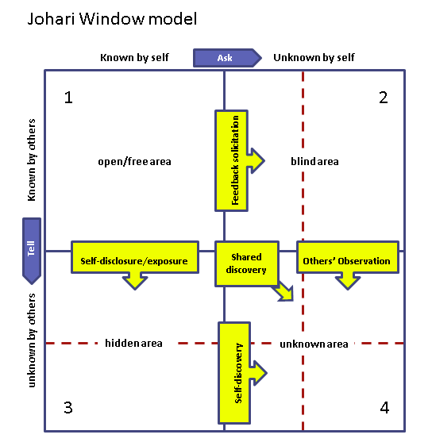
UNIT 2: Self leadership and self awareness
SECTION 2.3.: Cultivating self-awareness: The Johari window technique
A psychological tool created by Luft and Ingham in 1955)
Helps understanding and training self-awareness
Emphasis on soft skills (e.g. behavior, empathy, co-operation, inter-group and interpersonal development
Applicable to a variety of situations and environments
Source: selfawareness.org.uk

Slide 14
UNIT 2: Self leadership and self awareness
SECTION 2.3.: Cultivating self-awareness: The Johari window technique
Quadrant 1: Open area Things we know about ourselves and others know about us. The part that you are able to discuss freely with others. Most of the time you agree with this view you have and others have of you. | Quadrant 2: Hidden self Things we know about ourselves that others do not know. In this part you hide things that are very private about yourself, this maybe to protect yourself, because you feel ashamed or vulnerable, or perhaps because of modesty.
Quadrant 3: Blind self Things others know about us that we do not know. E.g. You might see yourself as an open-minded person when, in reality, people around you don’t agree. This area also works the other way. You might see yourself as a “dumb” person while others might consider you incredibly bright. | Quadrant 4: Unknown self Things neither we nor others know about us. This might refer to untapped potential talents and skills that have yet to be explored by you, your friends, colleagues or managers.
Source: warwick.ac.uk
Source: selfawareness.org.uk

Slide 15
UNIT 2: Self leadership and self awareness
SECTION 2.3.: Cultivating self-awareness: The Johari window technique
How it works?
Start in open area by self-reflection
Take feedback
Be receptive towards feedback
Consider whether to incorporate
Source: selfawareness.org.uk

Slide 16
Source: Zigarmi 2018 @medium.com
UNIT 2: Self leadership and self awareness
SECTION 2.4.: Cultivating self-leadership
Recognize limits of your mode of behaviour
Take responsibility for your actions and reactions
Grow self-awareness
Analyse regularly when, why and under which circumstances you reacted in certain way
Practice self-awareness techniques each time you feel overwhelmed
Define your personal leadership goals and purpose
Make operative goals and milestones
Practice self-efficacy
Assess own leadership competences
Analyse successes and competences that led to them
Practice self-acceptance
Accept yourself without self-criticism and self-sabotage
Acknowledge parts where you are good and where to improve
Work on self-management
Manage time and resources
Learn to prioritize and leave time for personal development
Try to avoid multitasking
Develop self-reflection routine
Devote time of day for self-reflection
Identify opportunities for improvement and growth

Slide 17
Key takeaways:
Knowing inner you is a first step towards personal growth and happiness
Being self-aware helps us to combat different challenges life throws on us
Self-awareness requires continuous exploration of ourselves
Self-leadership helps us not only to better manage ourselves but also to be better leader to others

Slide 18
Assessment test
Knowing inner self matters for:
a.- To combat anxiety, stress and depression
b.- To better combat challenges
c.- All of above
2. Being self-aware helps
a.- emotion control
b.- sleeping disorder
c.- does not help at all
3. Following types of self-awareness exist:
a.- internal
b.- external
c.- mixed
4. Following practices are not relevant for self-awareness:
a.- mindfulness
b.- cooking
c.- car driving
5. Self-leadership and self-awareness are:
a.- positively related
b.- unrelated
c.- negatively related

Slide 19
UNIT 2: Self Leadership and Self Awareness
SOURCES
Du Plessis, M. (2019). Positive self-leadership: A framework for professional leadership development. In L. E. Van Zyl & S. Rothman, Sr. (Eds.), Theoretical approaches to multi-cultural positive psychological interventions (p. 450). Springer International Publishing.
https://pooja.coach/self-awareness/whats-self-awareness-how-does-it-lead-to-success/
Duval, S. and Wicklund, R.A. (1972). A theory of objective self-awareness. Academic Press
Eurich, T. (2018). What Self-Awareness Really Is (and how to Cultivate It). Harward Business Review.
Betz, M. (2021). Why self-awareness is the key skill for growth, health, and happiness. betterup.com
https://myquestionlife.com/examples-of-self-awareness-in-everyday-life/
https://www.businessnewsdaily.com/6097-self-awareness-in-leadership.html
https://www.selfawareness.org.uk/news/understanding-the-johari-window-model
https://warwick.ac.uk/services/wss/topics/selfawareness/
https://medium.com/@dzigarmi/the-importance-of-self-leadership-and-how-to-leverage-it-to-improve-organizational-leadership-f32ffb64938c

Slide 20
Thank you!

