Slide 1
“Enhancing SMEs’ Resilience After Lock Down”
PSYCHOLOGICAL NEEDS AND MENTAL WELL-BEING - MAINTAINING CONNECTION WITH WORLD AROUND YOU
By: UNIVERSITY OF DUBROVNIK

Slide 2
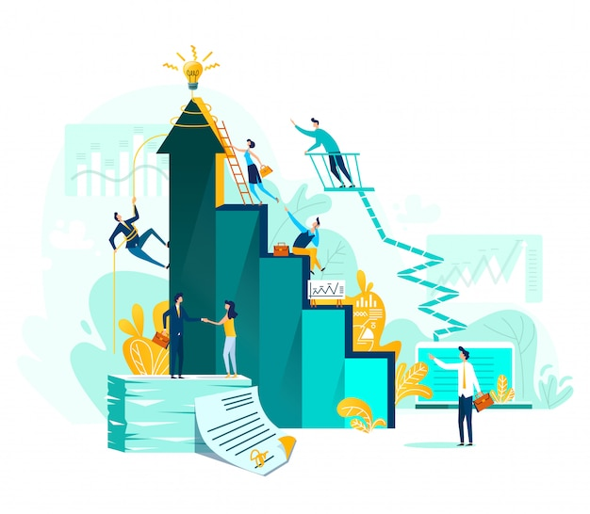
OBJECTIVES AND GOALS
At the end of this module you will be able to:
Define digital well-being
Identify ways to maintain connection with your team
Identify rules for successful remote work communication
Determine activities for maintaining connection with world around you

Slide 3
INDEX
Unit 2: Maintaining connection with world around you
Defining digital well-being
Maintaining connection with your team
Remote work communication
Connection with the outside world

Slide 4
UNIT 2: Maintaining connection with world around you
SECTION 2.1.: Defining digital well-being
The rapid utilization of digital technologies and their acceptance by society has changed our relationships to ourselves, each other, and our environment.
Our well-being is closely connected with the state of our digital environment that mediates our interaction with it, which poses pressing questions concerning the impact of digital technologies on our well-being (Floridi, 2014).
„The term ‘digital well-being’ is used to refer to the impact of digital technologies on what it means to live a life that is good for a human being” (Burr et al., 2020)

Slide 5
UNIT 2: Maintaining connection with world around you
SECTION 2.1.: Defining digital well-being
There are plenty of opportunities to leverage everyday technology to improve one’s wellbeing and quality of life (Cecchinato et al. 2019). Technology can enhance wellbeing through:
enhanceing social connectedness
supporting mental health
providing enjoyment.

Slide 6
UNIT 2: Maintaining connection with world around you
SECTION 2.1.: Defining digital well-being
There are many definitions of empathy and it is difficult to settle on a single one:
“The enhancement and improvement of human well-being, in the intermediate and long term, through the use of digital media.” (Gui et al., 2017)
„Digital wellbeing is a subjective individual experience of optimal balance between the benefits and drawbacks obtained from mobile connectivity. This experiential state is comprised of affective and cognitive appraisals of the integration of digital connectivity into ordinary life. People achieve digital wellbeing when experiencing maximal controlled pleasure and functional support, together with minimal loss of control and functional impairment.” (Vanden Abeele, 2021)

Slide 7
UNIT 2: Maintaining connection with world around you
SECTION 2.1.: Defining digital well-being
…
“the impact of digital technologies on what it means to live a life that is good for a human being” (Burr et al., 2020)
“the impact that digital technologies, such as social media, smartphones, and AI, have had on our well-being and our self-understanding of what it means to live a life that is good for us in an increasingly digital society” (Burr and Floridi, 2020)

Slide 8
UNIT 2: Maintaining connection with world around you
SECTION 2.2.: Maintaining connection with your team
It’s important that companies create an environment where leadership and employees can stay connected while working from home.
8 Things to stay connected with your remote team (https://www.flexjobs.com/employer-blog/stay-connected-team-working-from-home-remotely/):
Coffee Chats
encourage your employees to take regular virtual coffee breaks with the team to stay connected while working from home.

Slide 9
UNIT 2: Maintaining connection with world around you
SECTION 2.2.: Maintaining connection with your team
Ask a Question of the Week
Encourage Groups Chats
your staff would appreciate the chance to connect with coworkers with similar interests
set up some virtual groups to facilitate conversation
Virtual Lunches
encourage staff to have a virtual lunch together

Slide 10
UNIT 2: Maintaining connection with world around you
SECTION 2.2.: Maintaining connection with your team
Exchanges
getting a package or letter in the mail.
Company Contests
a great way to get people together and encourage a little friendly competition
Virtual Workouts

Slide 11
UNIT 2: Maintaining connection with world around you
SECTION 2.3.: Remote work communication
Work from home trends have shaped how we connect with one another. Rules for successful remote work communication are (https://www.halfhalftravel.com/remote-work/stay-connected-while-working-from-home.html):
Communicate often.
Communicate when you have doubts.
Communicate when you have questions.
Communicate when you have concerns.
Communicate when you have feedback.

Slide 12
UNIT 2: Maintaining connection with world around you
SECTION 2.3.: Remote work communication
Communicate when you have results or successes.
Communicate your schedule.
Communicate updates.
Communicate eloquently.
Communicate clearly.

Slide 13
UNIT 2: Maintaining connection with world around you
SECTION 2.4.: Connection with the outside world
„without regular human interaction (and digital interaction doesn’t quite cut it), your isolation will start to take a toll psychologically, emotionally, and professionally.” (https://www.kalido.me/how-to-stay-connected-while-working-from-home/)

Slide 14
UNIT 2: Maintaining connection with world around you
SECTION 2.4.: Connection with the outside world
Some tips for working from home (https://www.kalido.me/how-to-stay-connected-while-working-from-home/):
Consider a co-working space
You will be surrounded by other professionals, and all the networking and collaboration opportunities that entails
Many co-working offices also have on-site cafés and restaurants
Catch up during lunch
catch up with some friends or professional contacts

Slide 15
UNIT 2: Maintaining connection with world around you
SECTION 2.4.: Connection with the outside world
Join interest and sports clubs
One danger of working alone is the increased possibility of stagnation. This could affect both your professional and personal life.
Meet with clients and collaborators in person
If you’re interested in making and maintaining good relationships (and relationships are after all the cornerstone of any successful business), you should be meeting up in person on a regular basis.
Take in-house projects
Working in-house lets you see the inner workings of the organisation

Slide 16
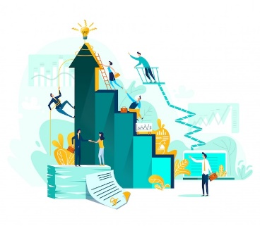
Key takeaways:
The term ‘digital well-being’ is used to refer to the impact of digital technologies on what it means to live a life that is good for a human being
Companies have to create an environment where leadership and employees can stay connected while working from home.
Staying connected while working from home should come naturally
Regular human interactions are important for mental and physical health

Slide 17
Assessment test
The impact of digital technologies on what it means to live a life that is good for a human being is:
a.- Digital well-being
b.- Social well-being
c.- Personal well-being
2. It’s important that companies create an environment where:
a.- leadership is separated from employees
b.- leadership and employees are not connected while working from home
c.- leadership and employees can stay connected while working from home.
3. Encouraging staff to have a virtual lunch together
a.- does not have any influence on human well-being
b.- will positively influence the connection with your team
c.- negatively influence work productivity
4. If you’re interested in making and maintaining good relationships with your clients you should:
a.- meet with clients in person
b.- take in-house projects
c.- join interest and sports clubs
5. For successful remote work communication it is important to:
a.- do not communicate when you have doubts
b.- communicate when you are bored
c.- communicate when you have doubts

Slide 18
Assessment test
The impact of digital technologies on what it means to live a life that is good for a human being is:
a.- Digital well-being
b.- Social well-being
c.- Personal well-being
2. It’s important that companies create an environment where:
a.- leadership is separated from employees
b.- leadership and employees are not connected while working from home
c.- leadership and employees can stay connected while working from home.
3. Encouraging staff to have a virtual lunch together
a.- does not have any influence on human well-being
b.- will positively influence the connection with your team
c.- negatively influence work productivity
4. If you’re interested in making and maintaining good relationships with your clients you should:
a.- meet with clients in person
b.- take in-house projects
c.- join interest and sports clubs
5. For successful remote work communication it is important to:
a.- do not communicate when you have doubts
b.- communicate when you are bored
c.- communicate when you have doubts

Slide 19
UNIT 2: Maintaining connection with world around you
SOURCES
Burr, C., & Floridi, L. (2020). The ethics of digital well-being: A multidisciplinary perspective. In Ethics of digital well-being (pp. 1-29). Springer, Cham.
Burr, C., Taddeo, M., & Floridi, L. (2020). The ethics of digital well-being: A thematic review. Science and engineering ethics, 26(4), 2313-2343.
Cecchinato, M. E., Rooksby, J., Hiniker, A., Munson, S., Lukoff, K., Ciolfi, L., Theim, A. & Harrison, D. (2019, May). Designing for digital wellbeing: A research & practice agenda. In Extended abstracts of the 2019 CHI conference on human factors in computing systems (pp. 1-8).

Slide 20
UNIT 2: Maintaining connection with world around you
SOURCES
Gui, M., Fasoli, M., & Carradore, R. (2017). “Digital well-being”. Developing a new theoretical tool for media literacy research. Italian Journal of Sociology of Education, 9(1).
Vanden Abeele, M. M. (2021). Digital wellbeing as a dynamic construct. Communication Theory, 31(4), 932-955.
https://www.flexjobs.com/employer-blog/stay-connected-team-working-from-home-remotely/
https://www.halfhalftravel.com/remote-work/stay-connected-while-working-from-home.html
https://www.kalido.me/how-to-stay-connected-while-working-from-home/

Slide 21
Thank you!

